Slide 1

Exploring Careers in Bioinformatics Coding Breakout – Blue Group
NCRC B520 Rm 1140
August 18, 2025

Slide 2

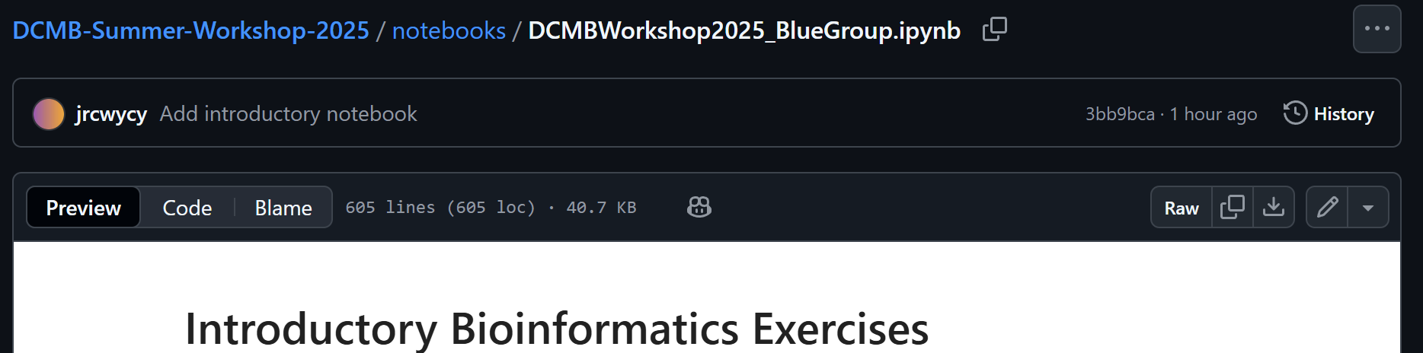
Accessing The Coding Notebook
Go to GitHub: https://github.com/lindmuir/DCMB-Summer-Workshop-2025
Go to notebooks
Download the BlueGroup notebook

Slide 3
Accessing The Coding Notebook
Go to Google Colab: https://colab.google/
Login to Google account when prompted
Click “Open Colab” >> click “Upload” >> Select downloaded notebook

Slide 4
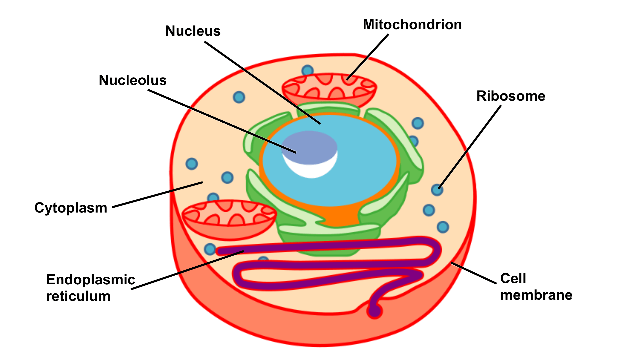
Basic Unit of Life?
Cells
Nucleus
Genes
DNA

Slide 5
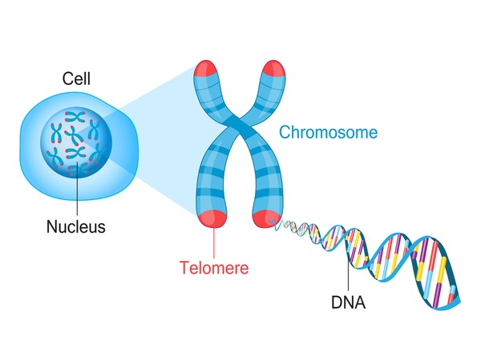
Genetic Information
GENES: Basic unit of genetic information. Genes determine the inherited characters.
GENOME: The collection of genetic information
CHROMOSOMES: Storage unit of genes
DNA (Deoxyribonucleic acid): Nucleic acid that contains the genetic instructions specifying the biological development of all cellular forms of life

Slide 6
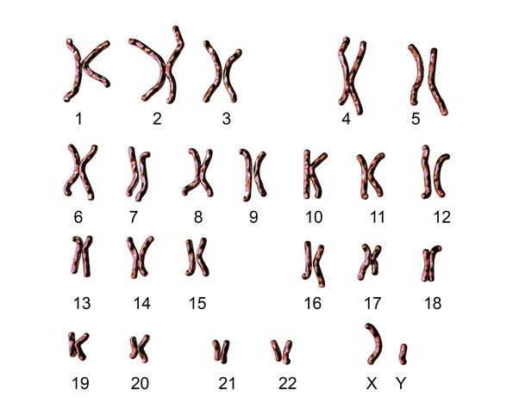
Human Genome
Humans are diploid organisms; they contain two sets of genetic information – one inherited from the mother and one from the father
Most human cells consist of 23 pairs or 46 chromosomes:
22 pairs of chromosomes called Autosomes
1 pair of Sex chromosomes – XX for females and XY for males
Is there DNA in any other parts of the cell?
Yes! Mitochondria contain small amount of DNA molecules inherited from the mother

Slide 7
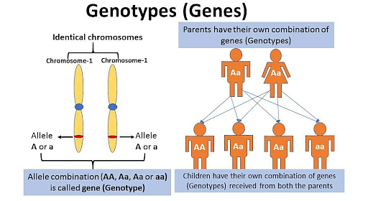
Genotype vs Phenotype
The genotype is the genetic arrangement that makes up the traits that an organism inherited from its parents.
Alleles: Two alternate variant form of a gene at a location on the chromosome
Phenotype is the observable expression of this genotype – a person's presentation

Slide 8
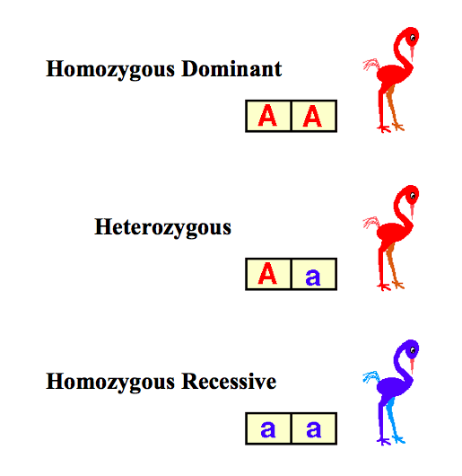
Genotype vs Phenotype – Example
(A) – red color
(a) – blue color
(Dominant allele)
(Recessive allele)
What do you observe about the colors of the birds?
Dominant alleles are expressed even if paired with a recessive allele, whereas recessive alleles are only expressed when paired with another recessive allele
Inheritance patterns of traits can be traced through pedigrees

Slide 9
How does Genotype translate into phenotype?
Phenotype is determined both through genetic make-up and environmental factors.
Let’s dig deeper into the genetic make-up!

Slide 10
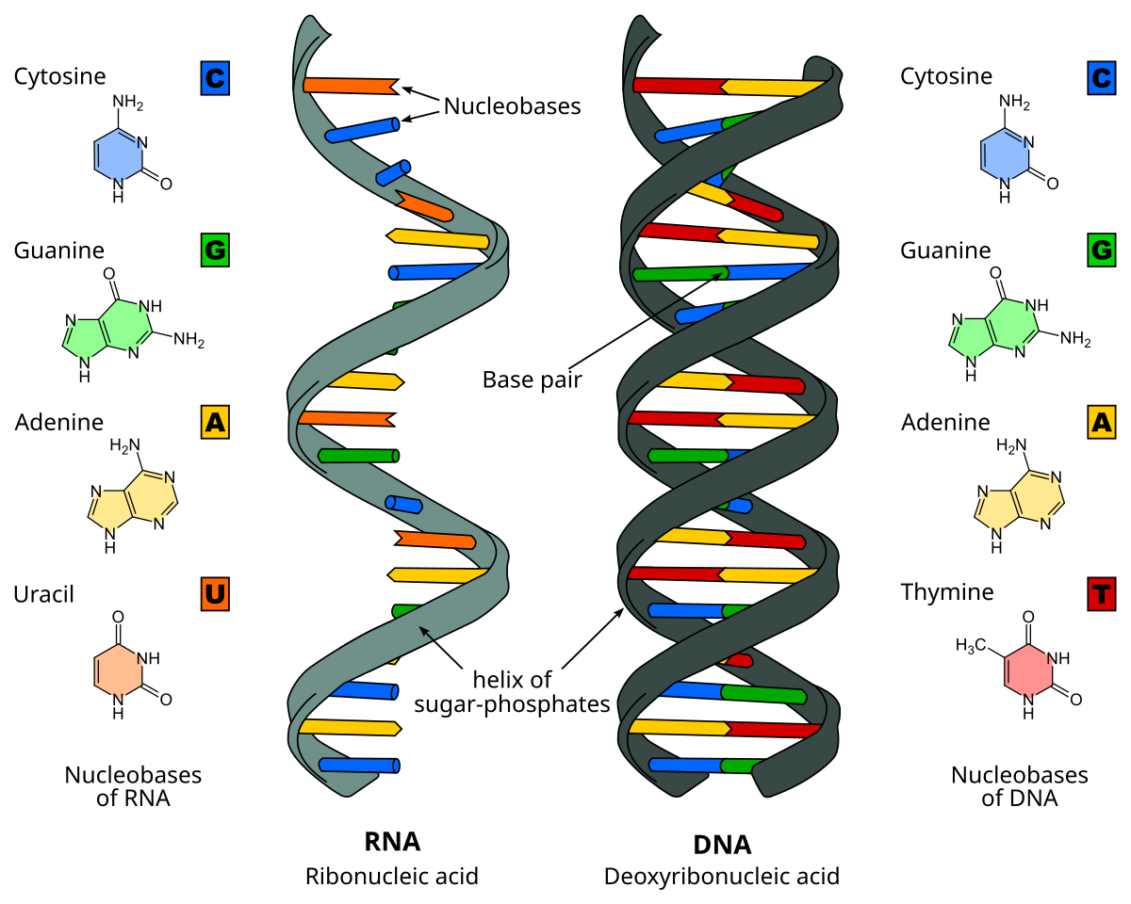
Two Types of Nucleic Acids
DNA: Stores the genetic material in the nucleus, comprises Cytosine, Guanine, Adenine, and Thymine
RNA: Transfers genetic information from nucleus to cytoplasm for protein synthesis, comprises Cytosine, Guanine, Adenine, and Uracil

Slide 11
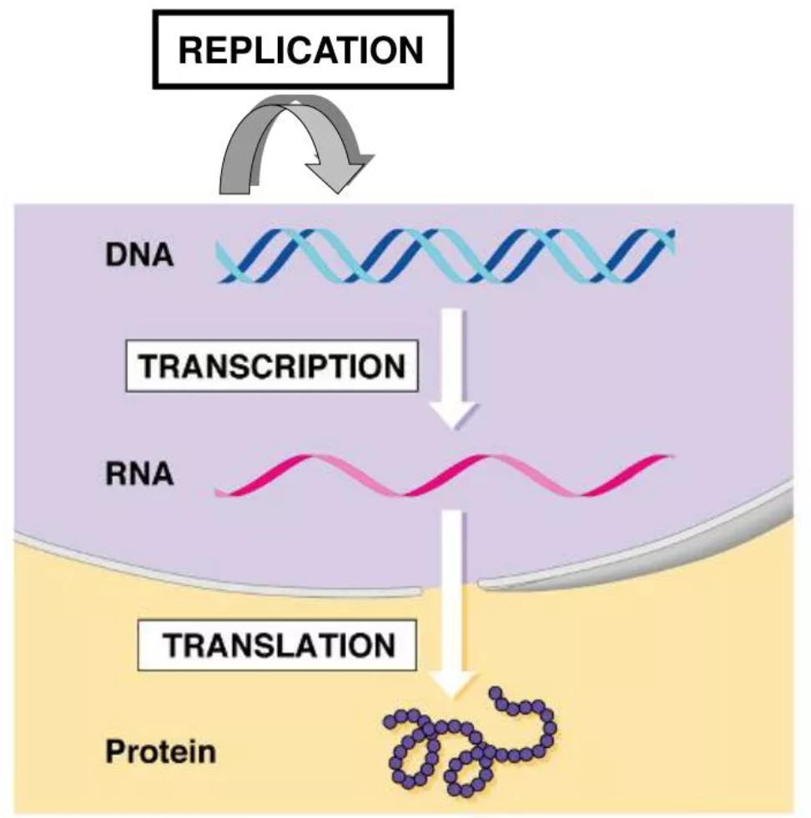
The Central Dogma
Francis Crick: Genetic information flows in one direction; from DNA to RNA to protein

Slide 12
Three Processes in the Central Dogma
REPLICATION
The process by which the genome's DNA is copied in cells. Before a cell divides, it must first copy (or replicate) its entire genome so that each resulting daughter cell ends up with its own complete genome.
This process occurs within the nucleus.
TRANSCRIPTION
The process of making an RNA copy of a gene’s DNA sequence. This copy, called messenger RNA (mRNA), carries the gene’s protein information encoded in DNA from the cell nucleus to the cell cytoplasm, where it is used for synthesizing the encoded protein.
This process occurs within the nucleus
TRANSLATION
The process by which mRNA is used to synthesize proteins. Translation takes place on ribosomes in the cell cytoplasm, where mRNA is read and translated into the string of amino acid chains that make up the synthesized protein.

Slide 13
Thank you!

